Slide 1
Part 2.3: Dipole Moments and Optical Activity

Slide 2
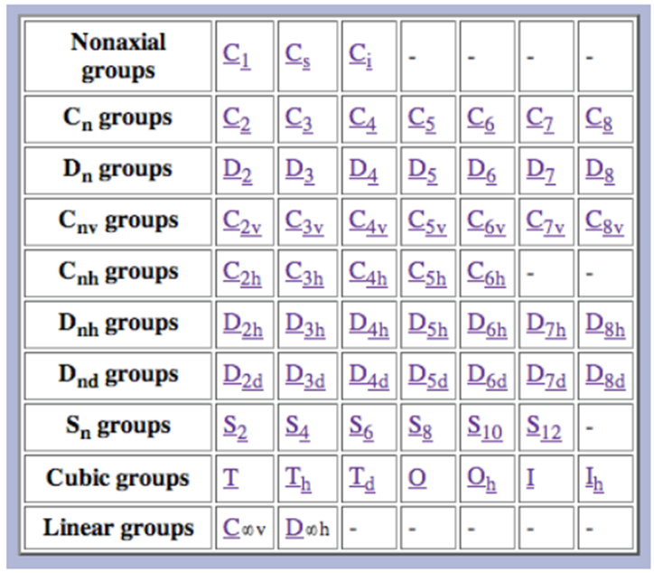
Types of Point Groups
Nonaxial (no rotation)
- C₁, C_{s}, C_{i}
Cyclic (rotational)
-C_{n}, C_{nv}, C_{nh}, S_{n}
Dihedral (⊥C₂)
- D_{n}, D_{nd}, D_{nh}
Polyhedral
- T, T_{h}, T_{d}, O, O_{h}, I, I_{h}
Linear
- C_{∞v}, D _{∞h}
http://symmetry.jacobs-university.de/

Slide 3

Outline
Dipole Moment/Polarity
Dipole and Symmetry
Dipole and Crystals
Chirality
Circular Dichroism
Optical Activity and Symmetry
Dynamic Molecules
Applications of CD

Slide 4


Polarity/Dipole Moment
Polarity- a separation of electric charge leading to a molecule or its chemical groups having an electric dipole moment.
Dipole moment- magnitude of charges and the distance of separation between the charges.
A molecule will have a dipole moment (that is, it will be polar) if the bond dipole moments do not cancel each other out.
Molecular Dipole Moment
Polar

Slide 5
Dipole Moment and Symmetry
A molecule will have a dipole moment (that is, it will be polar) if the bond dipole moments do not cancel each other out.
Molecular dipole is dependent on symmetry!
Any molecule with an inversion center (i) cannot have a dipole (or be polar).
Any molecule with a C₂ ⊥ to C_{n} cannot have a dipole (or be polar).
Any molecule with a σ_{h} cannot have a dipole (or be polar).

Slide 6
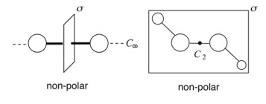
Dipole Moment and Symmetry
Any molecule with an inversion center (i) cannot have a dipole (or be polar).
i
2) Any molecule with a C₂ ⊥ to C_{n} cannot have a dipole (or be polar).
z
Can have a dipole in z or –z unless there is a ⊥ C₂ or a σ_{h}
y
x
3) Any molecule with a σ_{h} cannot have a dipole (or be polar).
Only C₁, C_{s}, C_{n}, C_{∞v} and C_{nv} can have a molecular dipole and be polar.

Slide 7
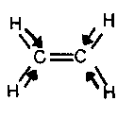
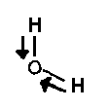
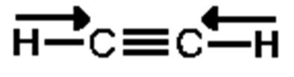
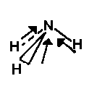
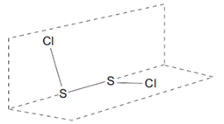
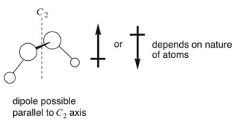
Dipole Moment and Symmetry
Any molecule with an inversion center (i) cannot have a dipole (or be polar).
Any molecule with a C₂ ⊥ to C_{n} cannot have a dipole (or be polar).
Any molecule with a σ_{h} cannot have a dipole (or be polar).
Only C₁, C_{s}, C_{n}, C_{∞v} and C_{nv} can have a molecular dipole and be polar.

Slide 8
Dipole Moment and Symmetry
Only C₁, C_{s}, C_{n}, and C_{nv} can have a molecular dipole and be polar.
Symmetry does not tell you the direction or the magnitude of the dipole moment.
Direction-
C₁ could be any direction (no axis)
C_{s} could be direction except ⊥ to σ_{h}
C_{n} and C_{nv} must be z or -z
z
z
y
y
x
x

Slide 9


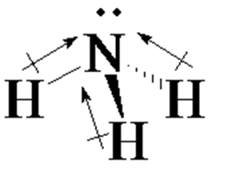

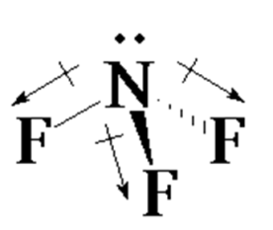


Dipole Moment and Symmetry
Only C₁, C_{s}, C_{n}, and C_{nv} can have a molecular dipole and be polar.
Symmetry does not tell you the direction or the magnitude of the dipole moment.
Direction-
C_{s} could be any direction (no axis)
C_{s} could be direction except ⊥ to σ_{h}
C_{n} and C_{nv} must be z or -z
Magnitude-
Depends on the atoms, lone pairs and bond dipoles
NH₃
?
NF₃
Bond Dipole
Lone pair
Molecular Dipole

Slide 10
Dipole Moment and Symmetry
Why symmetry and dipole moment matter?
Solubility
Miscibility
Boiling/melting points
pK_{a}
Vibrational Transitions
Crystal Structure/Property
Acetanilide
p-chloroacetanilide

Slide 11
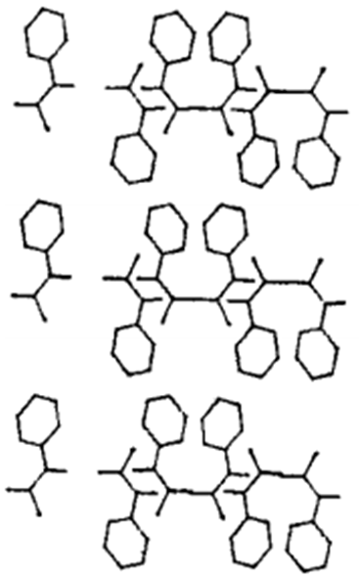
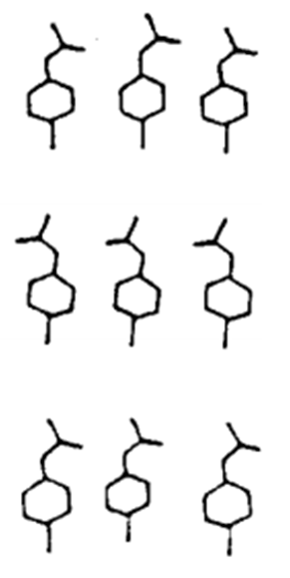
Dipole Moment and Symmetry
Acetanilide-
Form pairs related by an inversion center.
Cancelation of dipoles.
p-chloroacetanilide-
Head to tail alignment.
Aligned dipoles.

Slide 12
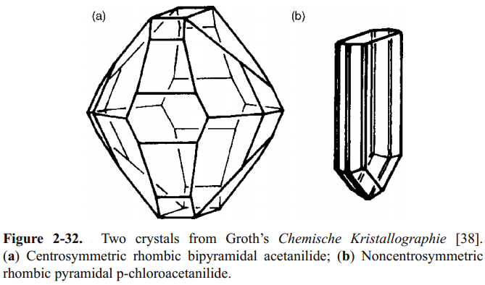
Dipole Moment and Symmetry
Non-polar crystal
Polar crystal
Symmetry Through the Eyes of a Chemist

Slide 13
Dipole Moment and Symmetry
Non-polar crystal
Polar crystal
Solid/gas reactions
Melting temp
Hardness
Conductivity
Optical Polarity
Pyroelectricity
-must have dipole
Piezoelectricity
Symmetry Through the Eyes of a Chemist

Slide 14
Dipole Moment and Symmetry
Any molecule with an inversion center (i) cannot have a dipole (or be polar).
i
2) Any molecule with a C₂ ⊥ to C_{n} cannot have a dipole (or be polar).
z
Can have a dipole in z or –z unless there is a ⊥ C₂ or a σ_{h}
y
x
3) Any molecule with a σ_{h} cannot have a dipole (or be polar).
Only C₁, C_{s}, C_{n}, C_{∞v} and C_{nv} can have a molecular dipole and be polar.

Slide 15
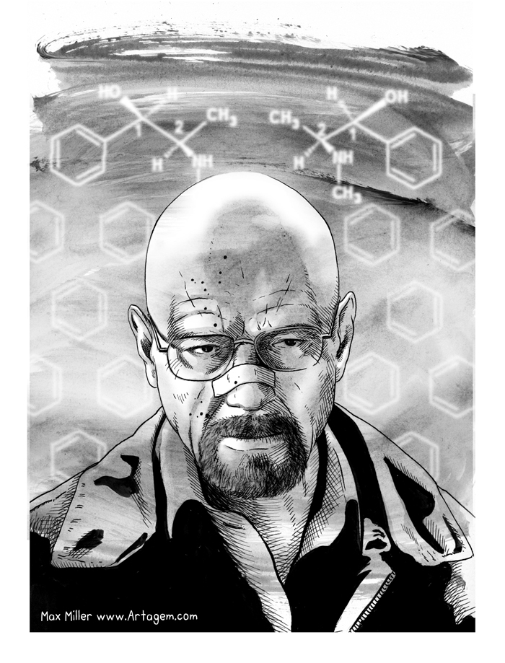
Optical Activity and Symmetry
Chirality
Circular Dichroism
Optical Activity and Symmetry
Dynamic Molecules
Applications of CD

Slide 16
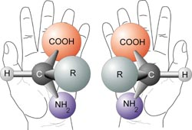
Chiral Molecules

Slide 17
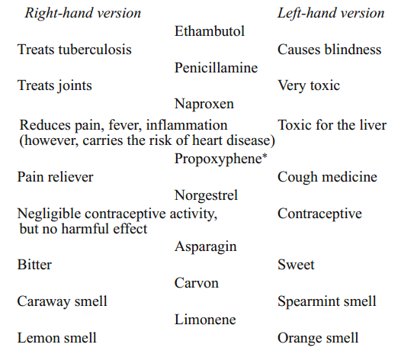
Why Chirality Matters
DNA is right handed
Amino acids are L
Carbohydrates are D
Alpha Helix is right handed
Origin/Evolution of life
Drug delivery/processing
Olfactory receptors

Slide 18
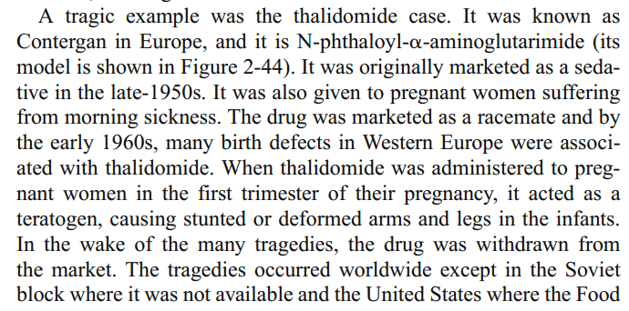
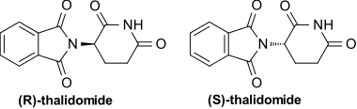
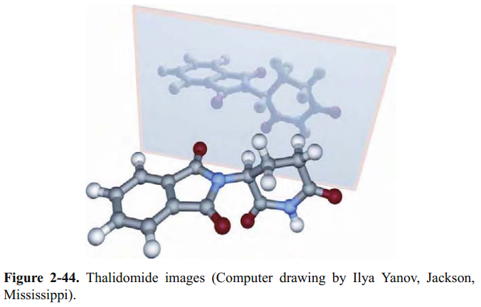
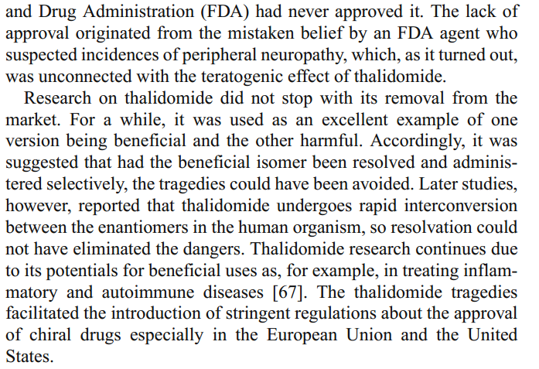
Importance of Chiral Molecules

Slide 19
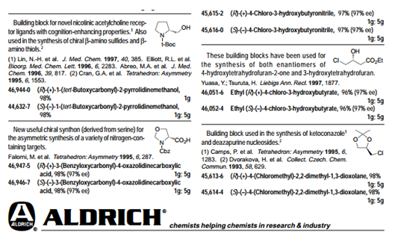
Naming Conventions
R / S, d/l and (+)/(−) are not related.
R / S system- requires no reference molecule (Cahn–Ingold–Prelog priority rules)
d/l system- referenced vs glyceraldehyde.
(+)/(−) system- related to the direction to which it rotates plane polorized light.
(+) –rotates the plane polarized light clockwise (when viewing towards the light source)
(-) –rotates the plane polarized light counterclockwise

Slide 20
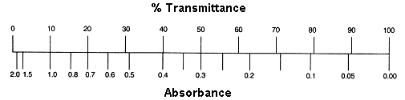
Optical Activity
hν
hν
Sample
We don’t measure absorbance. We measure transmittance.
Sample
Transmittance:
T = P/P₀
P₀
P
Absorbance:
A = -log T = log P₀/P
(power in)
(power out)

Slide 21
Beer’s Law
The Beer-Lambert Law (λ specific):
A = ε c l
Sample
A = absorbance (unitless, A = log₁₀ P₀/P)
ε = molar absorptivity (L mol⁻¹ cm⁻¹)
l = path length of the sample (cm)
c = concentration (mol/L or M)
P₀
P
(power in)
(power out)
l in cm
Concentration
Absorbance
Path length
Absorbance
Molar Abs.
Absorbance

Slide 22
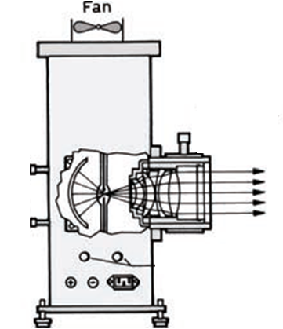
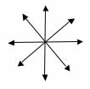
UV-Vis Spectroscopy
Detector
Sample
End View
Unpolarized Light

Slide 23
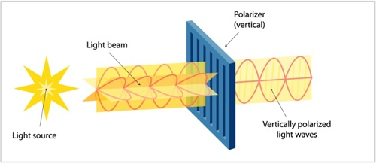
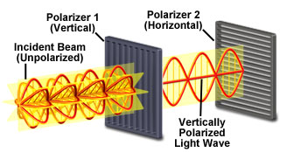
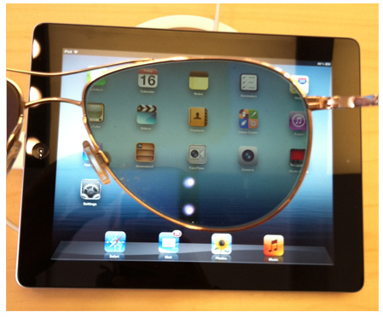
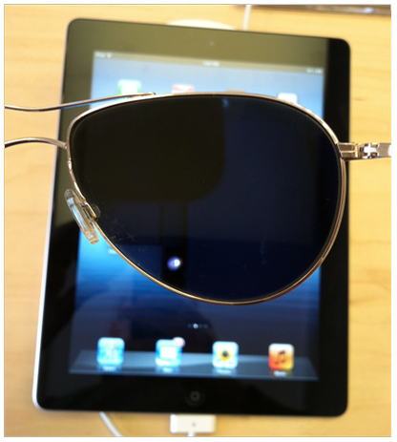
Polarizers

Slide 24
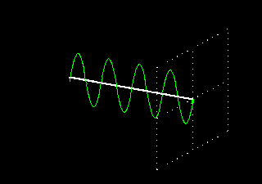
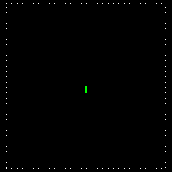
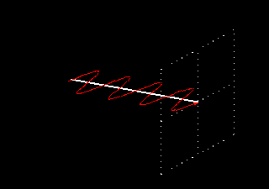
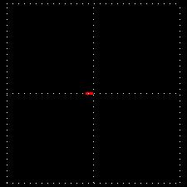
Polarization of Light
Vertically Polarized
Side View
End View
Horizontally Polarized
http://www.enzim.hu/~szia/cddemo/edemo0.htm

Slide 25
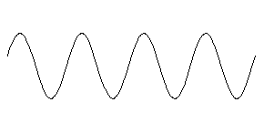
Light + Molecules
Source
Strong Absorption
Weak Absorption

Slide 26
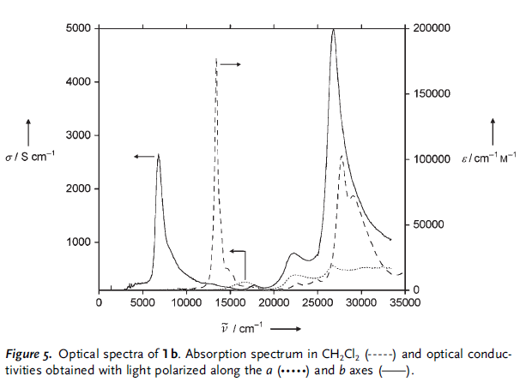
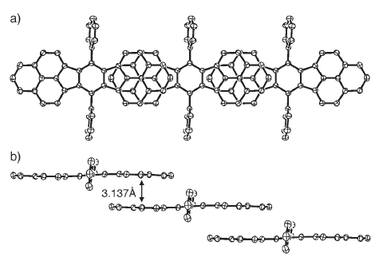
Orientation Dependent Absorption
a axis
b axis
Angew. Chem. Int. Ed. 2005, 44, 6564 –6568

Slide 27
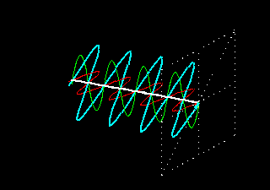
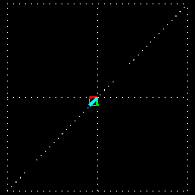
Adding Polarized Light
In phase (peak at the same time) + same amplitude
Vertical + Horizontal = 45° diagonal

Slide 28
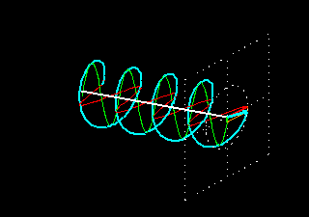
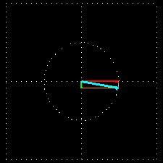
Adding Polarized Light
¼ λ (90°) out of phase + same amplitude
Vertical + Horizontal = Circular
Green peaks when red baselines.
Sum (blue) is always 1.

Slide 29
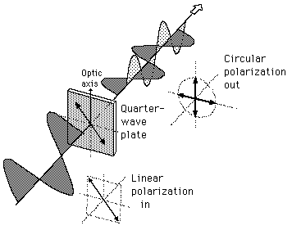
λ/4 Wave Plate Polarizer
λ/4 Wave Plate Polarizer

Slide 30
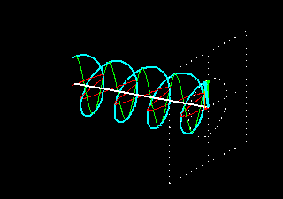
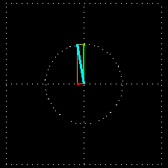
Polarization of Light
left-circularly polarized
Side View
End View
right-circularly polarized

Slide 31
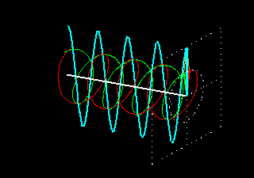
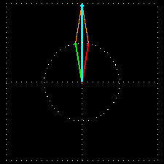
Adding Polarized Light
In phase (peak at the same time) + same amplitude
left circular + right circular = vertical
Green peaks when red peaks.

Slide 32
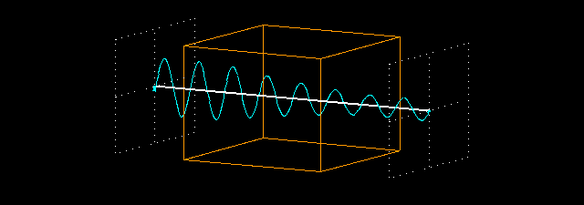
Absorption Spectroscopy
P₀
P
(power in)
(power out)
P
P₀
Absorbance:
A = -log T = log P₀/P

Slide 33
Optically Active Molecules

Slide 34
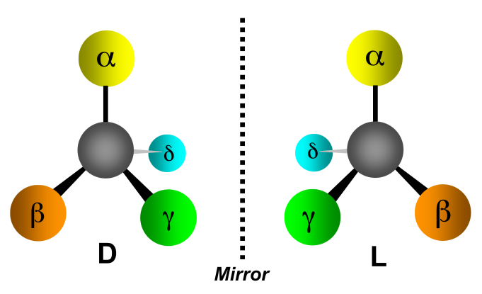
Absorption Spectroscopy
The Beer-Lambert Law:
A = ε c l
ε is the same for D and L
If C are equal:
50:50 D to L
100% D
100% L
Then A is the same.
A = absorbance (unitless, A = log₁₀ P₀/P)
ε = molar absorptivity (L mol⁻¹ cm⁻¹)
l = path length of the sample (cm)
c = concentration (mol/L or M)
Assuming the light is unpolarized!

Slide 35
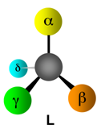
Circular Absorption
Absorbs Less
Larger P
left-circularly polarized
right-circularly polarized
Absorbs more
Smaller P
P₀
P
(power in)
(power out)

Slide 36
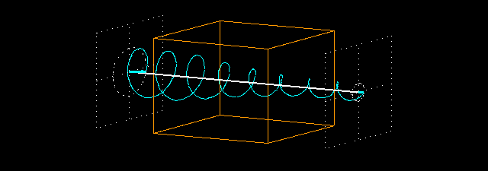
Circular Absorption
P_{(left)}
P_{0(left)}
Absorbance:
A_{(left)} = log P_{0(left)} /P_{(left)}
A_{(right)} = log P_{0(right)}/P_{(right)}
P₀
P
(power in)
(power out)

Slide 37




Circular Dichroism
CD measures the difference between the absorption of left and right handed cirularly-polarized light:
Δε is typically <100 M⁻¹ cm⁻¹
ε is typically > 10,000 cm⁻¹
CD spectra reported in ellipticity (θ) or Δε
θ = 3298 Δε.
ε in L/mol cm (liters mol⁻¹ centimeters⁻¹)
θ in degrees cm²/dmol⁻¹ (degrees centimeters² mol⁻¹)

Slide 38
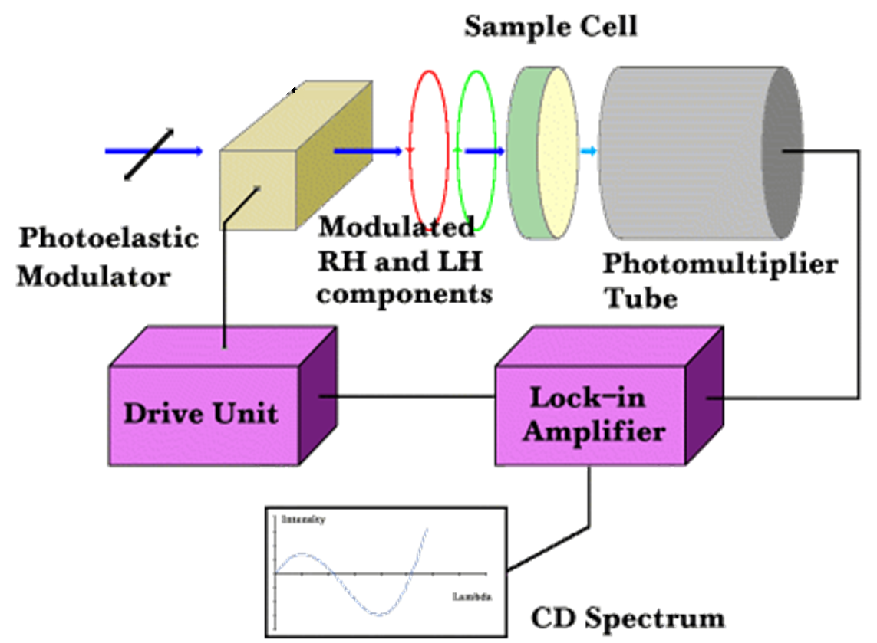
Circular Dichroism
Source
Polarizer
Prism
Process:
1) Unpolarized white light
2) Monochrometer
3) Plane polarizer
4) left-right modulator
5) left (then right) through sample
6) measure P for right (then left) through sample

Slide 39
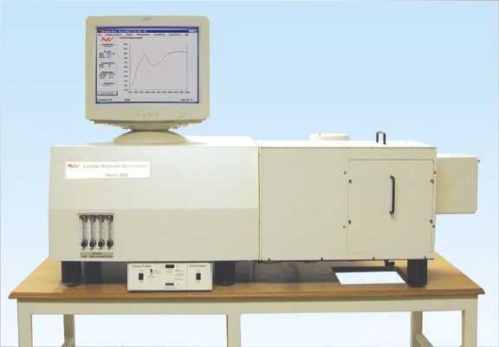
CD Spectrometer
AVIV 202 CD spectrometer
Institute of Molecular Biophysics
170-875 nm
-10ºC to 110ºC
titrator attachment

Slide 40









Optical Activity and Symmetry
Molecules are optically active if it contains at least one chiral center.
Many molecules have no chiral centers and yet are optically active.

Slide 41
Optical Activity and Symmetry
Which molecules are expected to be optically active?
Molecules with no improper axis of rotation (S_{n}) are optically active.
Note S₁ = σ and S₂ = i.
Chiral molecules lack an improper axis of rotation (S_{n}), a center of symmetry (i) or a mirror plane (σ)!
Nonaxial (no rotation)
- C₁, C_{s}, C_{i}
Cyclic (rotational)
-C_{n}, C_{nv}, C_{nh}, S_{n}
Dihedral (⊥C₂)
- D_{n}, D_{nd}, D_{nh}
Polyhedral
- T, T_{h}, T_{d}, O, O_{h}, I, I_{h}
Linear
- C_{∞v}, D _{∞h}
C₁, C_{n}, and D_{n}
Also T, O, and I

Slide 42
Optical Activity and Symmetry
Chiral molecules lack an improper axis of rotation (S_{n}), a center of symmetry (i) or a mirror plane (σ)!
C₁, C_{n}, and D_{n}

Slide 43





Optical Activity and Symmetry
Chiral molecules lack an improper axis of rotation (S_{n}), a center of symmetry (i) or a mirror plane (σ)!
C₁, C_{n}, and D_{n}
Also T, O, and I

Slide 44



Spectra
Absorption
Circular Dichroism

Slide 45



Optical Activity and Dynamic Molecules
10^{^10} per second
CD spectra-average of both isomers (at room temperature).

Slide 46


Photoreaction
hν
?

Slide 47
Optical Activity and Symmetry
UV-Vis or CD
source
hν
?

Slide 48


Optical Activity and Symmetry
Absorption
CD spectrum
time
hν
?

Slide 49

Optical Activity and Symmetry
Decomposition
Photoisomerization

Slide 50




Applications
• Determination of secondary structure of proteins
• Investigations of protein-protein interactions
• Investigation of the effect of drug binding
• Protein structure in a membrane
• Stereoselective synthesis
• Dynamic processes
- protein folding
- reaction dynamics
• DNA denaturation
GCN4-p1 coiled–coil

Slide 51


Side Note

